Slide 1
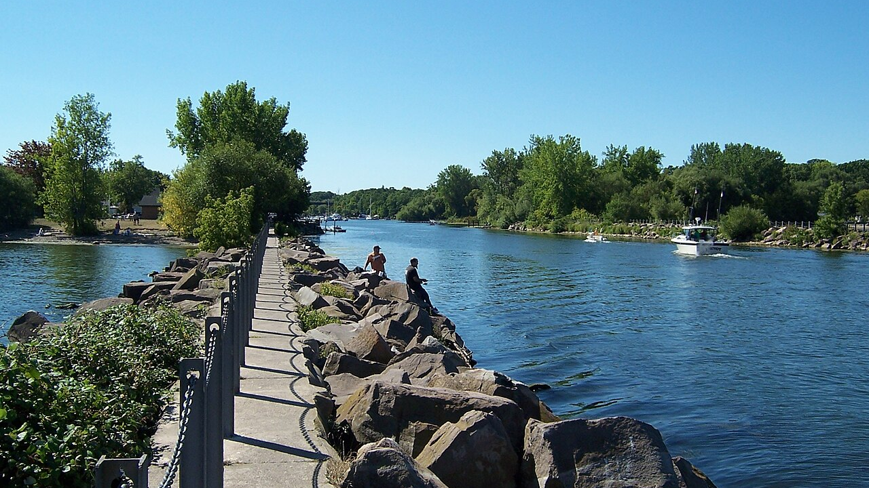
Town of Carlton Comprehensive Plan Update
September 23, 2026

Slide 2
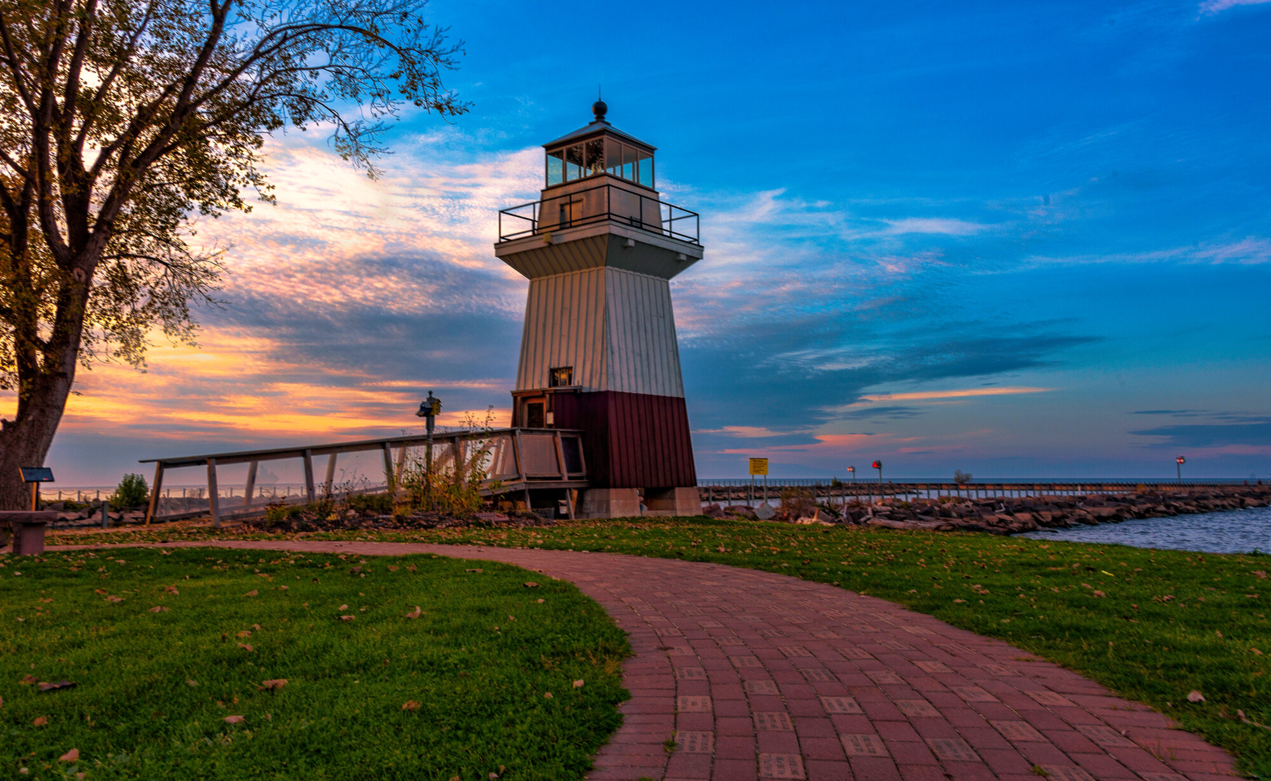
Agenda
What is a comprehensive plan?
Planning process
What we have heard?
Q&A
Activities

Slide 3
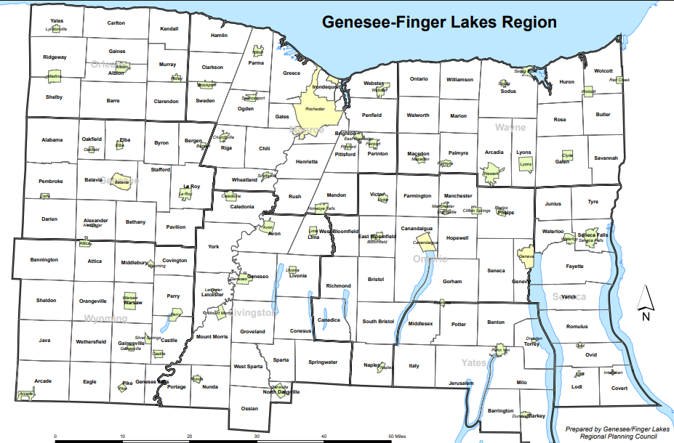
Genesee/Finger Lakes Regional Planning Council
Local planning council serving the nine-county Genesee- Finger Lakes region.
We work with municipalities throughout the region providing planning and local government technical assistance.
The Town of Carlton has contracted with us to provide technical assistance in updating the comprehensive plan.​

Slide 4
What is a Comprehensive Plan?
Long-range policy document designed to guide the future physical, economic, and social development of Carlton. This will act as the Town’s "blueprint” by establishing a shared 20- to 30-year vision and identifying the goals needed to get there.
Establishes goals, future needs and strategies
Supports a high quality of life
Gives residents a voice in decisions
Balances growth, services, & environmental protection
Prepares for change, challenges, & opportunities

Slide 5
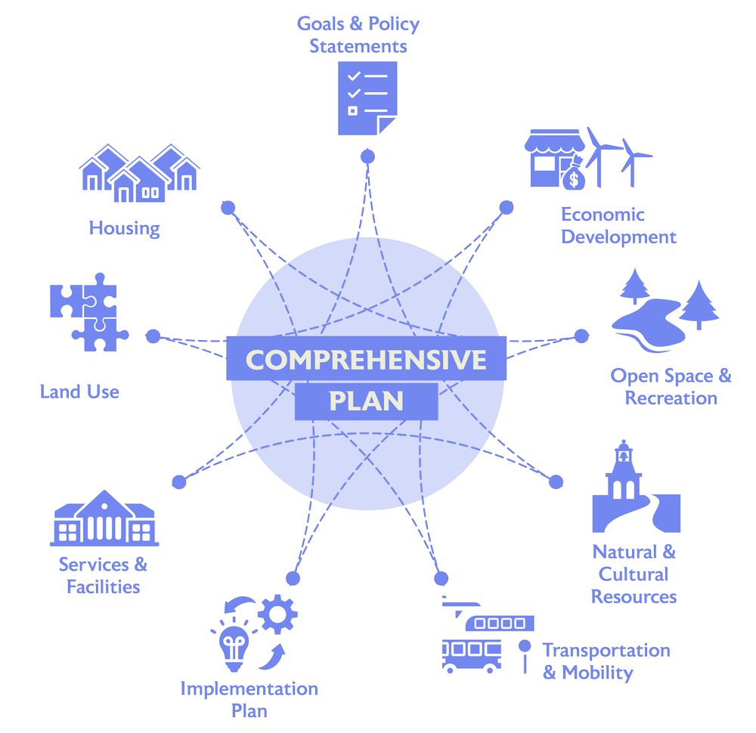
Key Elements

Slide 6
Planning Approach
Launch
  Coordinating with other project partners
  Review past plans, projects, & data.
Listening
  Engagement Plan
  Community Survey
Visioning
  Community Workshop
  Goal identification
Action
  Develop strategies & actions
  Implementation Plan
Adoption
  Public Hearing
  SEQR
  Planning Board
May- September 2026
September- November 2026
January-March 2026
March-May 2026
December 2026

Slide 7
What We Have Heard
What Residents Value
Small-town character
Waterfront access
Safety
Strong community
Rural setting & open space
Community Priorities
Support local businesses and add new businesses
Improve community amenities
Protect natural resources & waterfront access
Future Vision
More local services and jobs
Preserve Carlton's character while planning for the future

Slide 8
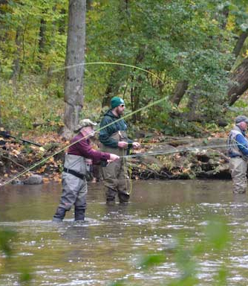
Carlton Draft Vision
Draft vision from the survey responses and from committee:
“The Town of Carlton is a rural community on the shores of Lake Ontario, shaped by its natural beauty, agricultural landscape, small-town character, and fishing traditions. As Carlton looks to the future, the Town is committed to preserving the qualities residents value most while guiding growth through thoughtful planning and smart investment. By protecting Carlton's rural identity, natural resources, and waterfront heritage, Carlton will continue to be a welcoming and resilient community for generations to come. ”

Slide 9
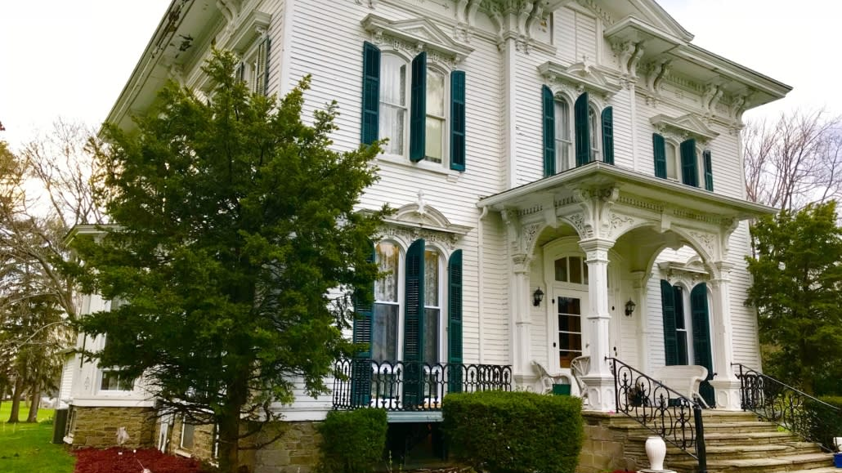
Questions?

Slide 10
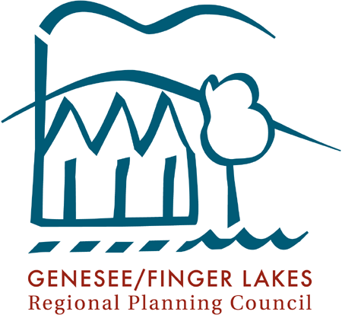
Thank You!
Please Reach Out
Jenny Loewenstein
Sustainability Program Manager,
G/FLRPC
Jloewenstein@gflrpc.org

